Slide 1
Engineering Interactive Visual Interfaces for Data Science (“The CS Data Vis Class”)
xkcd

Slide 2
Friday February 14
Engineering Interactive Visual Interfaces for Data Science
“The CS Data Vis Class”
Dr. Jillian Aurisano
Plan for today:
Logistics (5 min)
Marks and Channels
Data

Slide 3
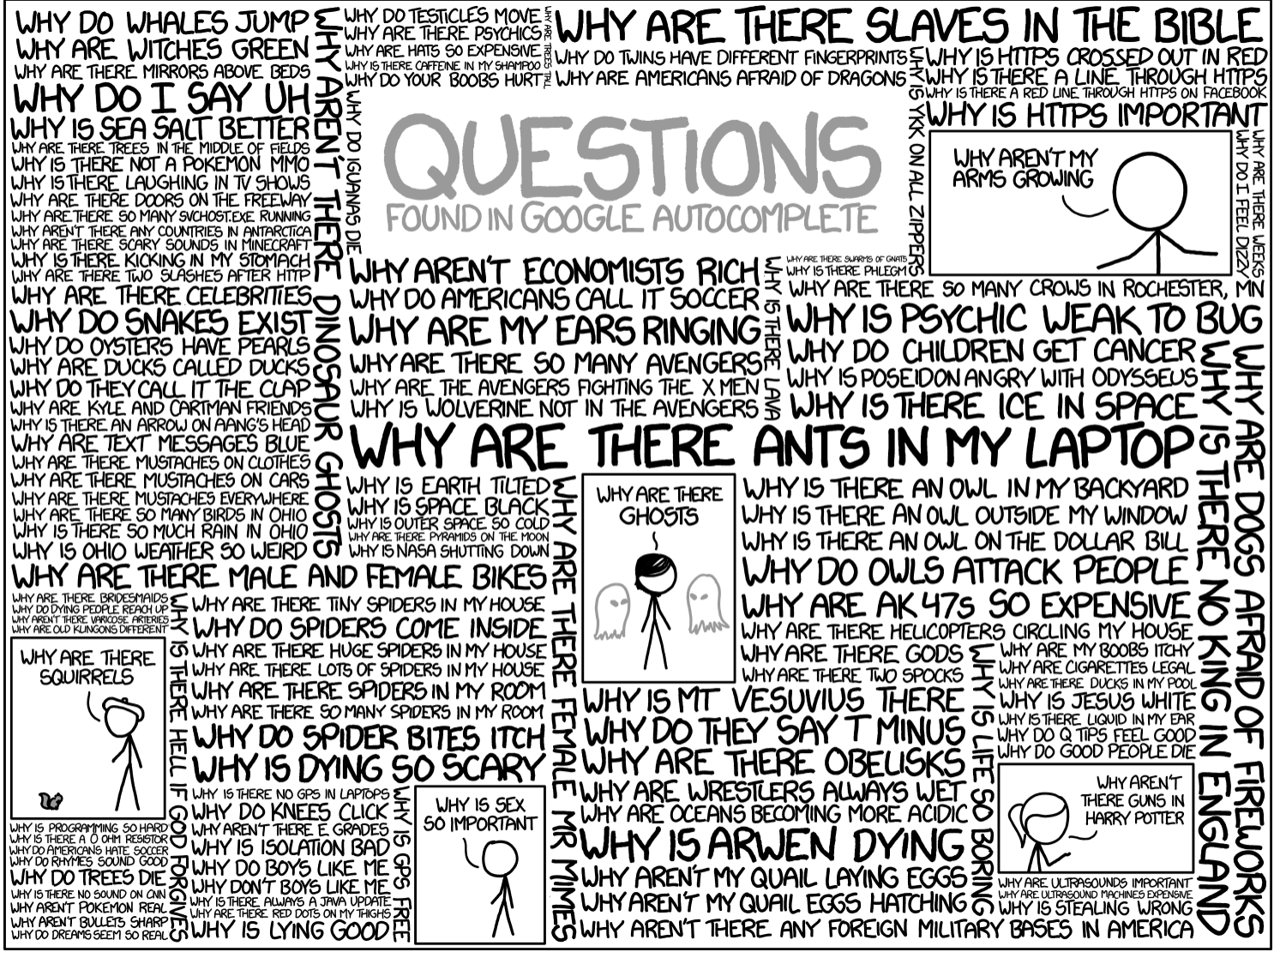
Questions?

Slide 4
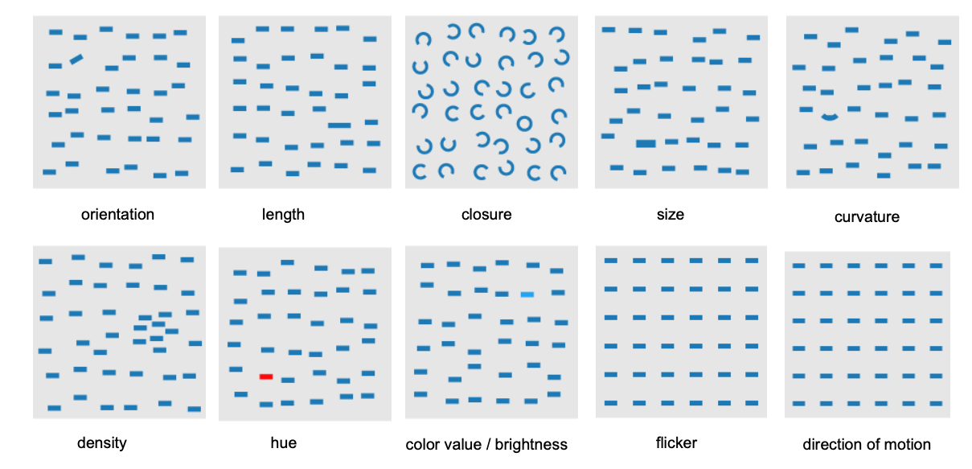
Visual channels
Visual channels- size, orientation, shape, hue…
Some are enable perceptual tasks like target identification, boundary detection, pre-attentively- without effort

Slide 5

Proximity
Proximity between elements creates an impression of association that overrides many other visual channels

Slide 6
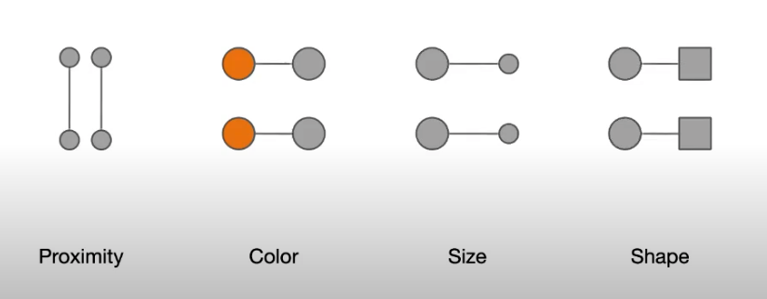
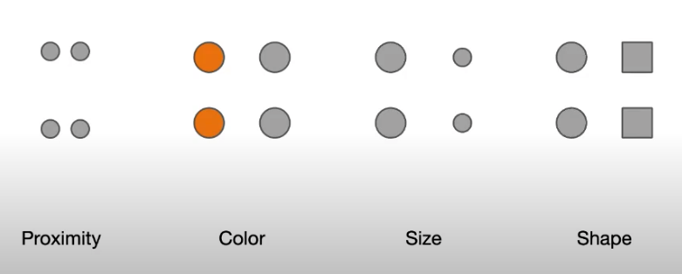
Monday- lines and boundaries
Lines and boundaries can beat our proximity and other visual channels to convey similarity (including positioning)

Slide 7
Color
Choosing appropriate color scales for your data
Consider is it quantitative, qualitative
Is it diverging (is there a midpoint you want to help someone spot)
Rainbow color maps vs monochromatic scales
Limits in the number of colors we can distinguish
6-10 is a good limit for colors of qualitative data/categorical
Color blindness- important factor to check

Slide 8
Today:
Data
Data semantics
Data types
Introduce dataset types
Attribute types
How to encode different data types and attribute types
Marks and channels

Slide 9
How can I visually represent these numbers
4 and 8
Spend a minute, sketch a few ideas

Slide 10
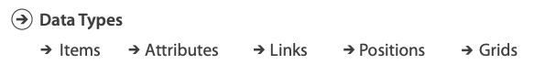
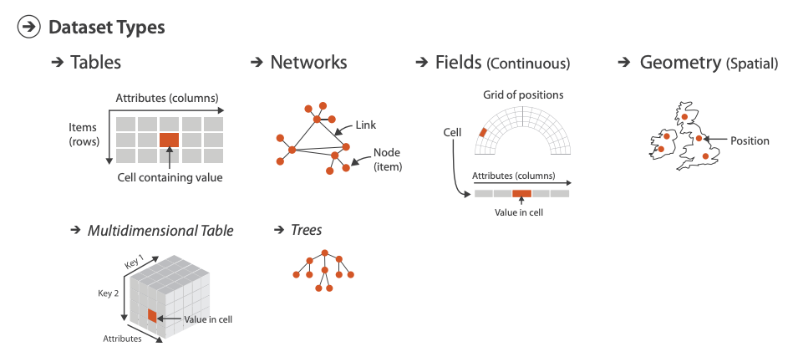
Let’s talk about data: data types, dataset types, data semantics
Data types
For given column in your table
Or one feature type on your dataset
Fundamental units of your data
Dataset types
What kind of dataset are you visualizing?
When data types are put together into a data set
Data semantics:
What does the data mean?

Slide 11
Data semantics
Data vector: Basil, 7, s, pear
What does this mean?
Need ‘semantics’- the meaning of the data values
Basil: Name? City? Plant?
8: Height? Age? Day of the Month?
S: Single? Small?
Pear: Fruit?

Slide 12
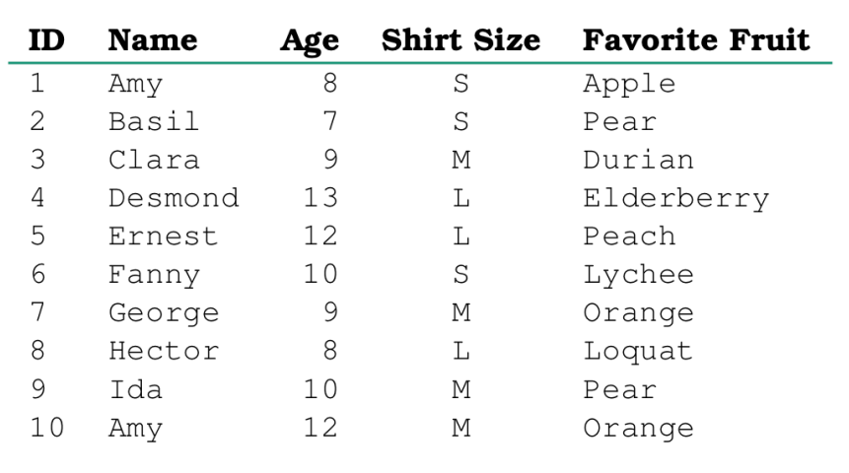
Data semantics
Meaning can be stored in metadata,
or understood through work with data generators/users

Slide 13
Data types
Not the data types in programming
Structural and mathematical interpretation of the data
Item, Link, Attribute, Position, Grid

Slide 14
What data types are in this table?

Slide 15
What data types are in this table?
Item’s: ID
Attributes: Name, Age, Shirt Size
Cell: Value
The Item’s Attribute Value
ID 1’s name = Julie

Slide 16
What about these tables?
Name | Follow list | Number of posts
Amy | (June, Ben) | 100
Ben | (Amy, Mark, Andrew) | 30
Mark | (June) | 6
Name | Follows | Date started following
Amy | June | 3/14/15
Amy | Ben | 3/15/15
Ben | Amy | 3/16/15
Ben | Mark | 3/16/15
Ben | Andrew | 3/17/18
Mark | June | 3/13/18

Slide 17
What about these tables?
Name | Follows | Date started following
Amy | June | 3/14/15
Amy | Ben | 3/15/15
Ben | Amy | 3/16/15
Ben | Mark | 3/16/15
Ben | Andrew | 3/17/18
Mark | June | 3/13/18
Name | Follow list | Number of posts
Amy | (June, Ben) | 100
Ben | (Amy, Mark, Andrew) | 30
Mark | (June) | 6
Items
Attributes about items
Links
Links
Attributes about the links

Slide 18
Other data types
Links
Express relationships between 2 items
Friendship on FB, Interaction between proteins
Positions
Spatial locations in 2d or 3d
Pixels in a photo, Voxels in MRI
Lat/Lon map

Slide 19
Let’s take a closer look at attributes
Qualities pertaining to items or links or positions

Slide 20
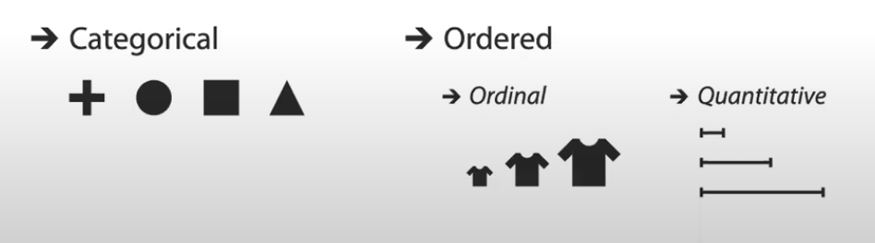
Attribute Types
Categorical (nominal , named data)
Separate classes
No ranking
Fruit, Movie Genres, File Types
Ordered (ordinal)
Greater than, less than defined
But no arithmetic (one thing isn’t 3x’s another)
Shirt size, Grade level….
Quantitative
Can do math on it
Length, Weight, Count, Temperature….
Important because different attribute types can be encoded in different ways

Slide 21
Guess the attribute type: Nominal (categorical/qualitative) Ordinal Quantitative
For each student, a table listing courses taken in school
Name of course (Intro to CS, Data structures, algorithms )
Letter grade in the course
Dates enrolled
Number of students in the course

Slide 22
Guess the attribute type: Nominal (categorical/qualitative) Ordinal Quantitative
For each student, a table listing courses taken in school
Name of course (Intro to CS, Data structures, algorithms ) Categorical
Letter grade in the course Ordinal
Dates enrolled Ordinal
Number of students in the course Quantitative

Slide 23
Why does it matter is something is nominal vs ordinal?
Monday, Tuesday…. Sunday
A, B, C, D, F
VS
Chocolate, Vanilla, Strawberry…
Cincinnati, St. Louis, Minneapolis….

Slide 24
Within Quantitative data
Quantitative data -> can do math on it
But what kind of math?
Interval
Ratio

Slide 25
Quantitative Data Types: Intervals
There are equal differences between successive points on the scale, but the position of zero is arbitrary
Ex- Temp is Celsius vs Temp in Fahrenheit
Celsius temp 0 has meaning (water freezes)
But not in Fahrenheit
Why is this important from a data vis perspective?
What kind of math can you perform in Celsius, but not on Fahrenheit?

Slide 26
Quantitative Data Types: Intervals
You can compute the distance (arithmetic + and – works)
The difference between 70 degrees and 80 degrees is the same as the distance between 60 degrees and 70 degrees
Can’t compute magnitude differences
20 degrees isn’t twice as hot as 10 degrees

Slide 27
Quantitative Data Types: Ratio
Relative magnitudes of scores and differences between them matter
The position of 0 is fixed
Zero – nothing of the measured entity is observed
Measurements: Length, Mass, Age, Weight, Speed
Can measure ratios and proportions
Somethings is twice as long
Something is half as fast
Etc

Slide 28
Data Types
Nominal (categories, labels)
Operations: =, ≠
Ordinal (ordered)
Operations: =, ≠, >, <
Interval (location of 0 is arbitrary)
Operations: =, ≠, >, <, +, - (distance)
Ratio (0 is fixed)
Operations: =, ≠, >, <, +, - (distance), x, ÷ (proportions)

Slide 29
Let’s look at some examples
What type of variable are these (Nominal, Ordinal, Interval, Ratio)
50 meter race times
College major
Amazon rating for a product (1, 2, 3, 4, 5 stars)
IQ score
Product name
Can we do math on it?
If so, can we double it and say it is twice as much?
If not, does it have an order?

Slide 30
Let’s look at some examples
What type of variable are these (Nominal, Ordinal, Interval, Ratio)
50 meter race times
Ratio (You can say someone is 2xs as fast)
College major
Nominal
Amazon rating for a product- (1, 2, 3, 4, 5 stars)
Interval (no zero)
IQ score
Interval (no meaningful 0)
Product name
Nominal

Slide 31
Data
We will cover dataset types more in future lectures in the class
Focus on tables of items with data attributes for a bit

Slide 32
Encoding data: Marks and Channels
Given data consisting in a set of items, attributes, links…
Lots of ways to encode data
We can break our options into
Marks (shapes, points, lines)
The things that are drawn
Channels (color, position, size)
How they are dawn

Slide 33
Encoding data: Marks and Channels
Marks (shapes, points, lines- things drawn) represent
items (independent variable like a person)
links (like connections between individuals in a social network)
positions
Channels (how they are drawn) represent:
The attribute associated with an item, link or position

Slide 34
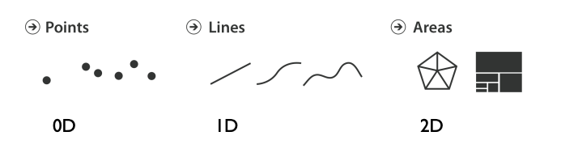
Marks for Items
Basic geometric elements
Points
Lines
Shapes, areas
Volumes

Slide 35
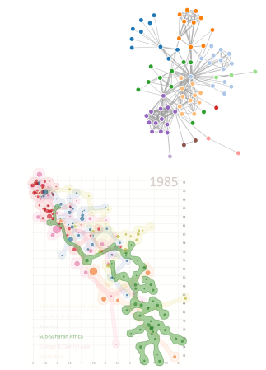

Marks for links and associations
Connection
Containment

Slide 36
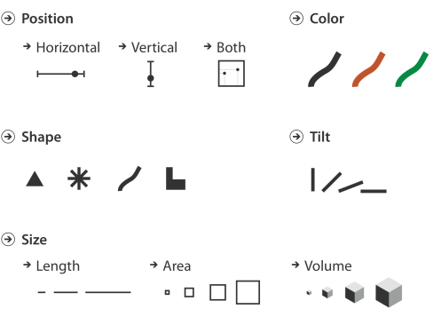
Channels
Control the appearance of marks based on attributes

Slide 37
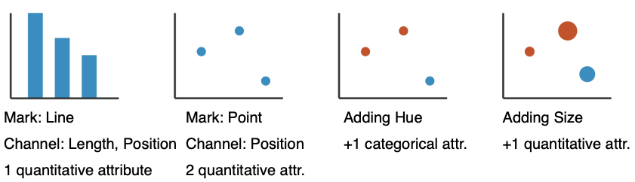
Using Marks and Channels
Can you describe these charts:
What is the mark for the items
How many items are encoded?
What channels are used for attributes?
How many attributes?

Slide 38
Using Marks and Channels
Can you describe these charts:
What is the mark for the items
How many items are encoded?
What channels are used for attributes?
How many attributes?

Slide 39
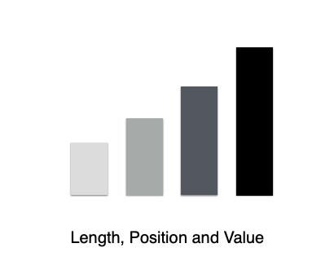
Let’s look at this
Can you describe these charts:
What is the mark for the items?
How many items are encoded?
What channels are used for attributes?
How many attributes?

Slide 40
Let’s look at this
Can you describe these charts:
What is the mark for the items?
How many items are encoded?
What channels are used for attributes?
How many attributes?
What is color (value differences) encoding here?

Slide 41
Redundant encoding
We don’t need the color differences to understand this data
There may be circumstances where this is warranted
Multiple views, want to associate items across views
But shouldn’t be necessary by default

Slide 42
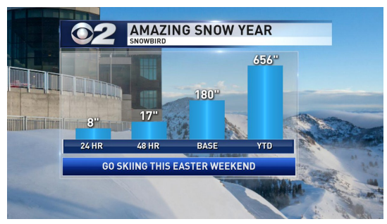
Consider these channels….

Slide 43
Consider these channels…
Use channels proportional to the data

Slide 44
Types of Channels
Magnitude Channels: How much? What rank?
Position
Length
Saturation
Apply to Ordinal or Quantitative Attributes
Identity channels: What is it?
Shape
Color (hue)
Spatial region/clustering
Categorical attributes

Slide 45
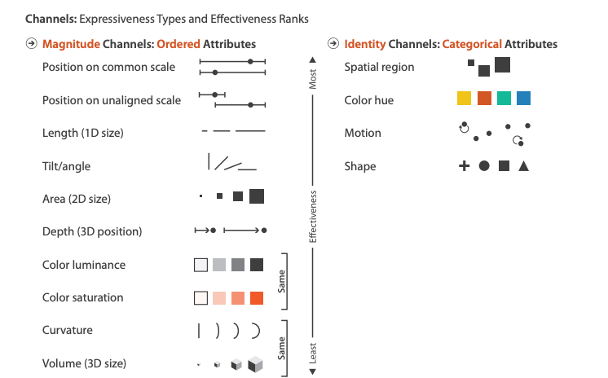
Magnitude Channels: How much? What rank?
Identity channels: What is it?

Slide 46
Characteristics of Channels
Selective
Can we make out the differences between two marks or values in a channel?
Associative
Does the channel support grouping?
Quantitative (Magnitude vs identity channels)
Can we quantify the difference between two selections in a channel?
Order
Can we see a change in order with this channel?
Length
How many unique options are within the channel?

Slide 47
Position?
Selective
Can we make out the differences between two marks or values in a channel?
Associative
Does the channel support grouping?
Quantitative (Magnitude vs identity channels)
Can we quantify the difference between two selections in a channel?
Order
Can we see a change in order with this channel?
Length
How many unique options are within the channel?

Slide 48
Position- Strongest visual variable
Selective: YES
Can we make out the differences between two marks or values in a channel?
Associative: YES
Does the channel support grouping?
Quantitative (Magnitude vs identity channels): YES
Can we quantify the difference between two selections in a channel?
Order: YES
Can we see a change in order with this channel?
Length: YES
How many unique options are within the channel?

Slide 49
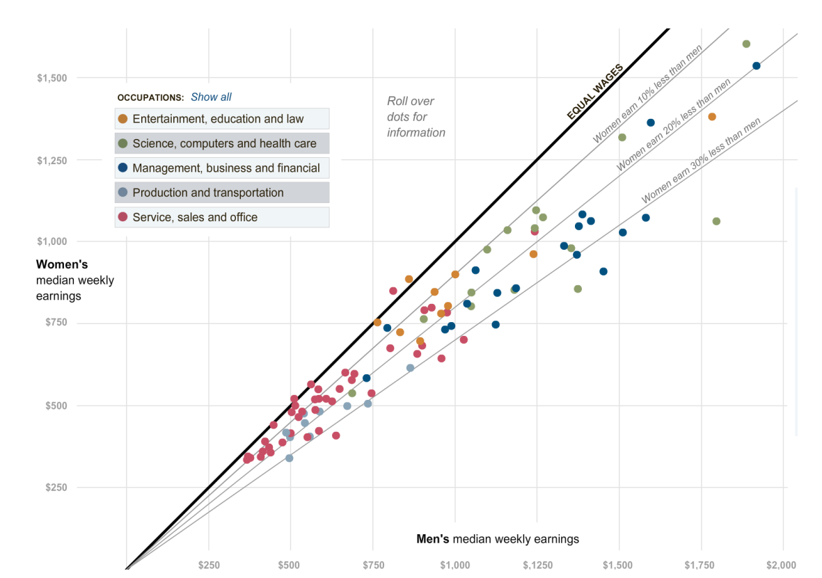
Example: Scatterplot

Slide 50
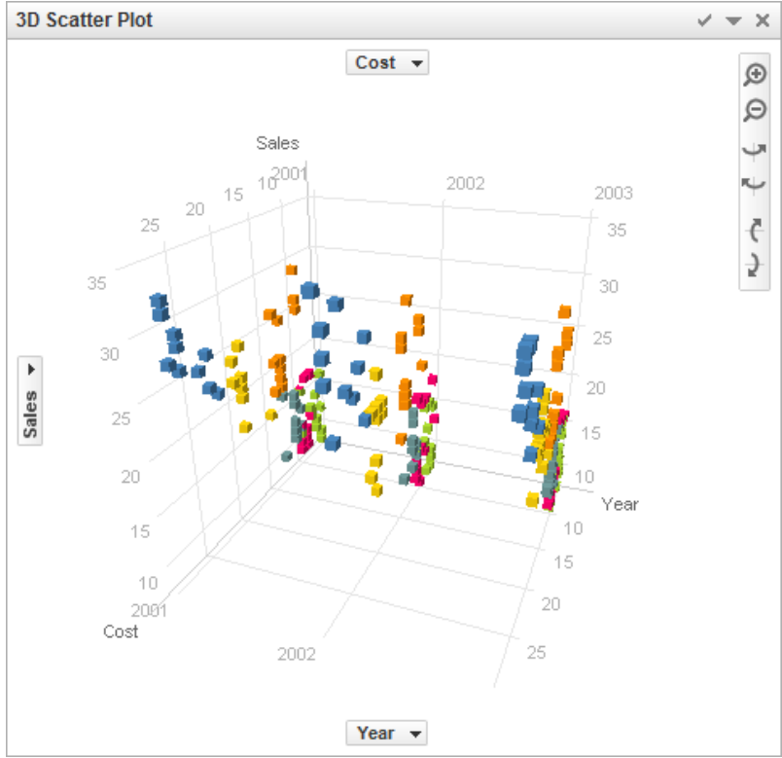
Position in 3D
Position in 3D is not the same as position in 2D
Harder to perform all those tasks, once you add a third dimension
Why?

Slide 51

Length and Size
Good for 1D: Length of line, length of rectangle
Ok for 2D: Area of circle
Bad for 3D: Volume of sphere
1D length:
Selective? Yes
Associative? Yes
Quantitative? Yes
Order? Yes
Length? Somewhat high
Example: bar chart

Slide 52
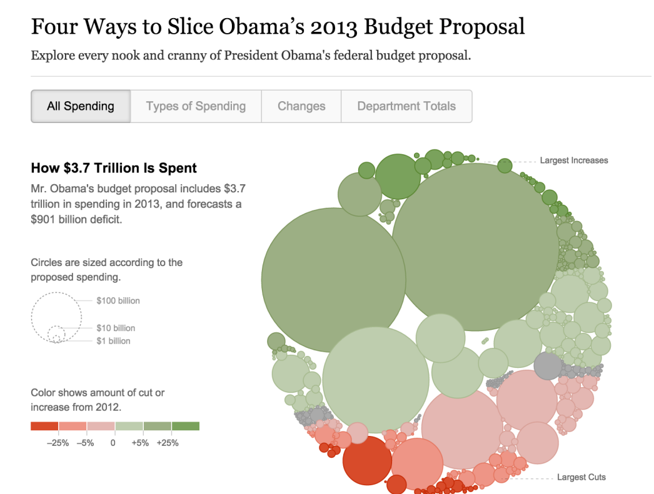
Example Area (2d size)

Slide 53

Value, Saturation, Luminance
Ok for quantitative data when length and size are already used
Not many shades are recognizable
Selective: yes
Associative: Yes
Quantitative: somewhat (with problems)
Order: yes
Length: Limited

Slide 54
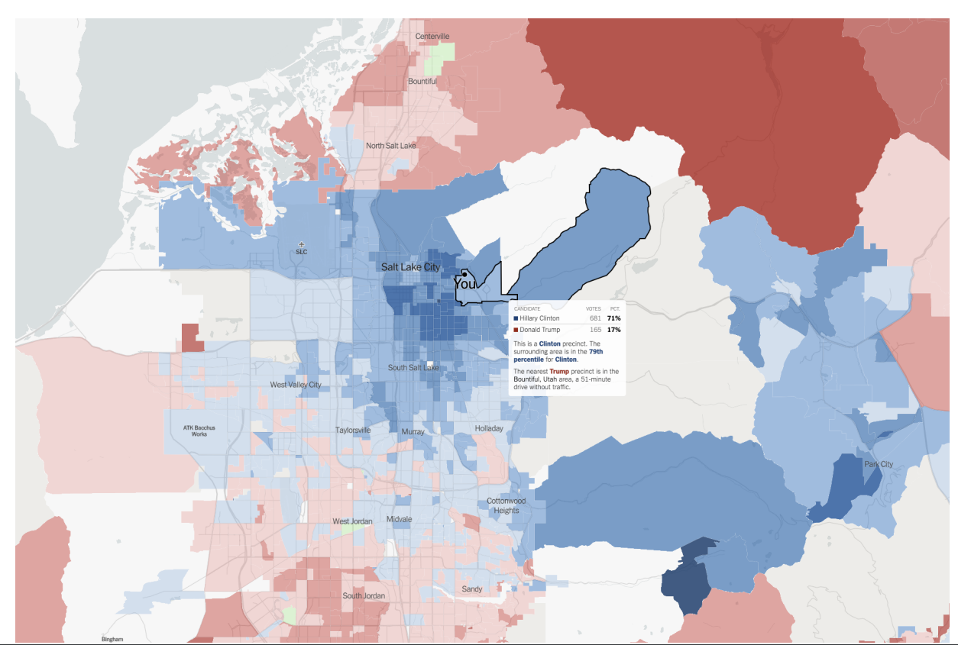
Example

Slide 55
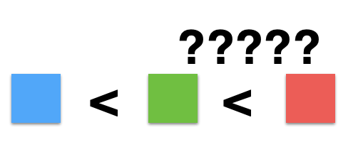

Color
Good for qualitative data (identity channel)
Limited number of classes/length (7-10)
Not suggested quantitative data
Except note recent controversy over rainbow color maps…
In general- be careful
Selective: yes
Associative: yes
Quantitative: less so
Order: no
Length: limited

Slide 56
Shape
Great to recognize many classes
Both the geometric shapes
AND things like choropleth maps, shapes of countries/states
Selective: yes
Associative: limited
Quantitative: no
Order: no
Length: vast

Slide 57
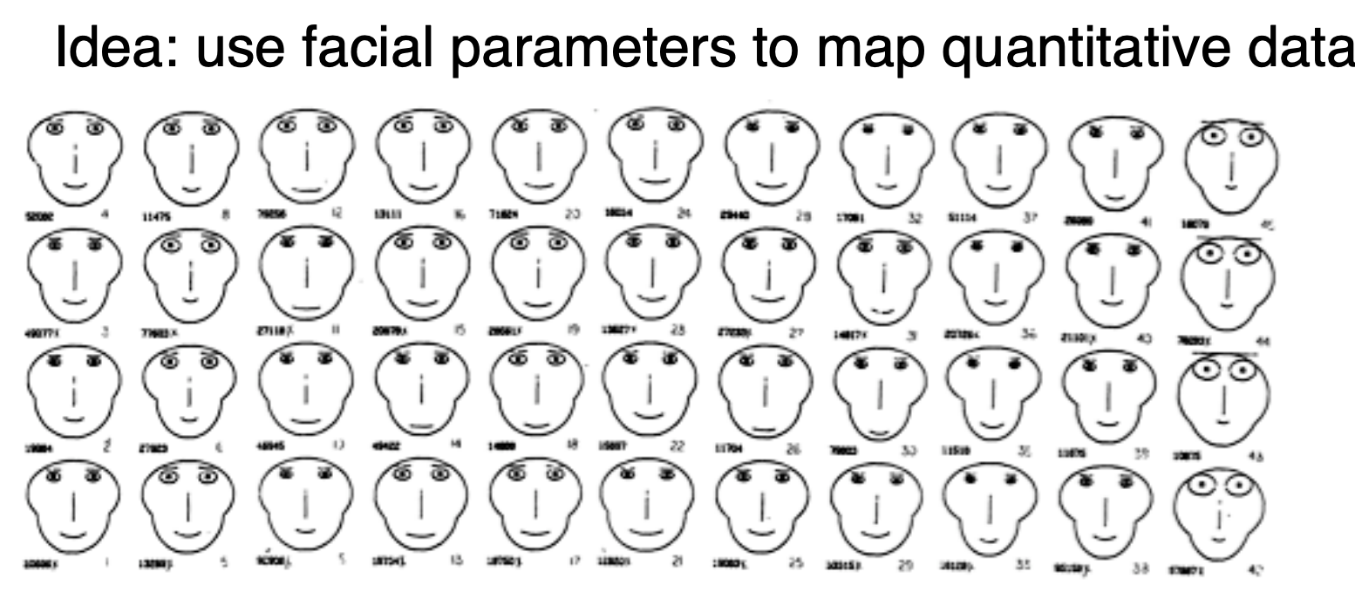
Chernoff faces
Can we use facial parameters to map quantitative data?
Eh… not really

Slide 58
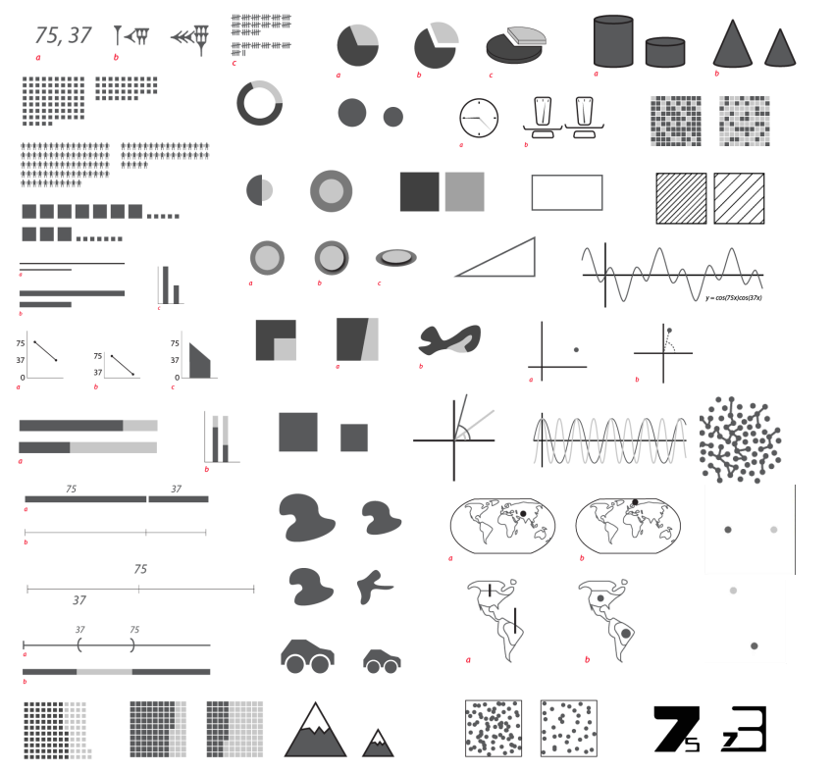
More ….??
Lots of ways to encode data…

Slide 59
What about others
Selective
Can we make out the differences between two values in a channel?
Associative
Does the channel support grouping?
Quantitative (Magnitude vs identity channels)
Can we quantify the difference between two selections in a channel?
Order
Can we see a change in order with this channel?
Length
How many unique options are within the channel?

Slide 60
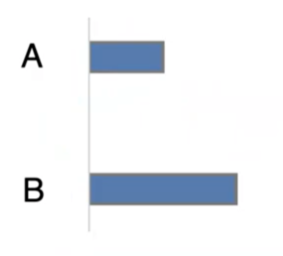
How much longer?

Slide 61
How much longer?
2x

Slide 62
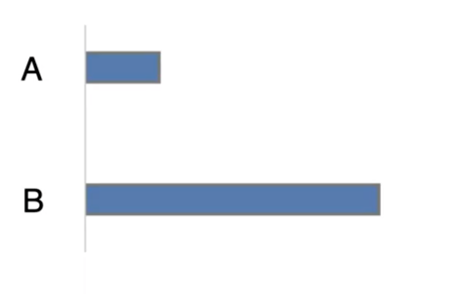
How much longer

Slide 63
How much longer
4x

Slide 64
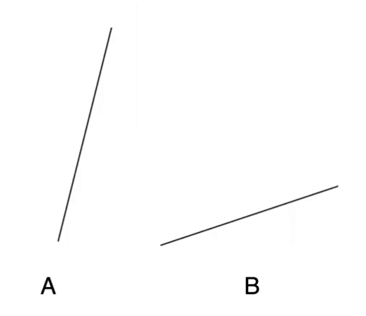
How much steeper?

Slide 65
How much steeper?
4x

Slide 66
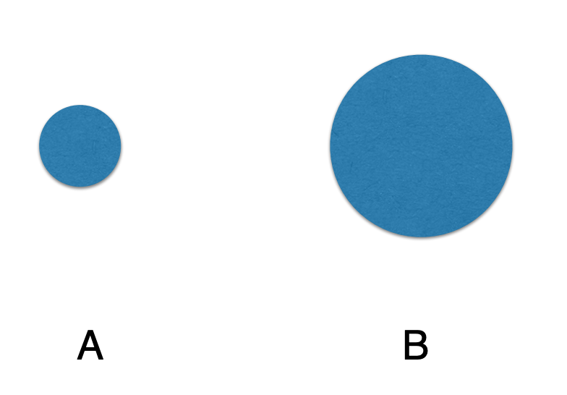
How much larger

Slide 67
How much larger
5x

Slide 68
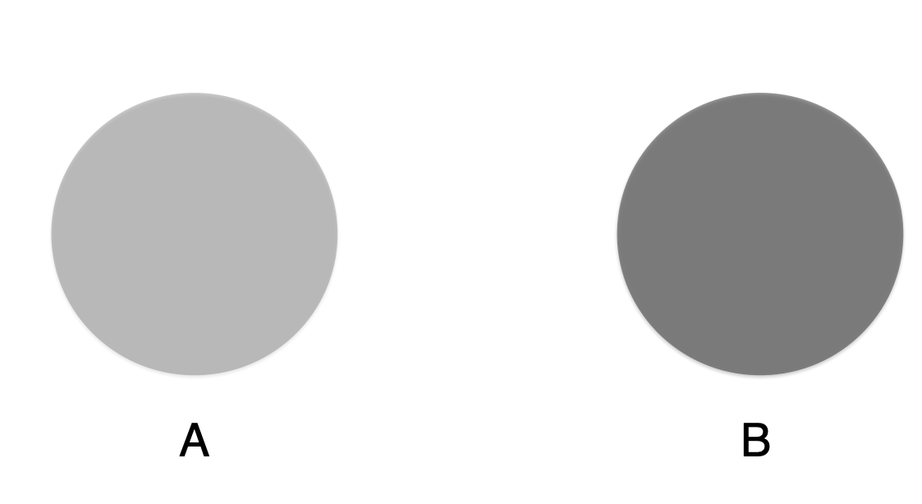
How much darker?

Slide 69
How much darker?
2x

Slide 70
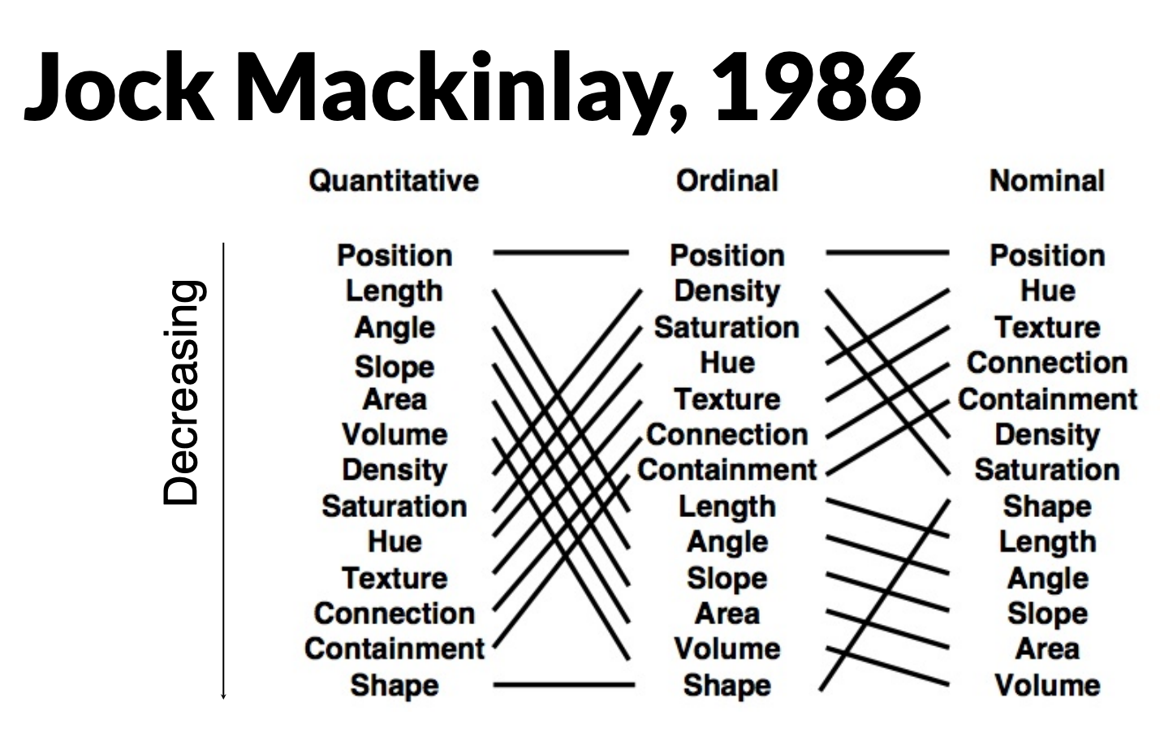

Slide 71
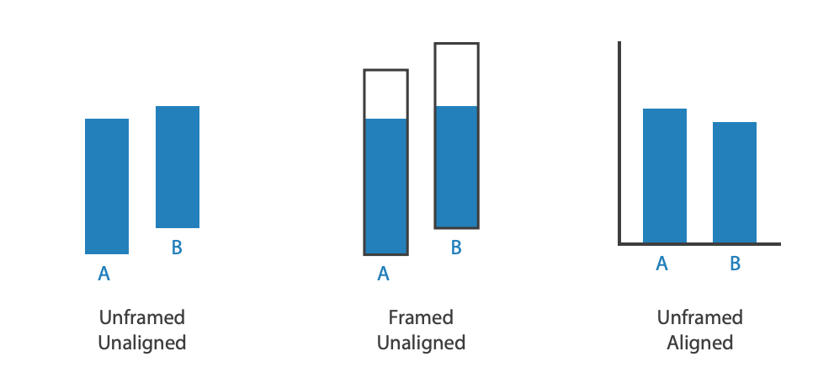
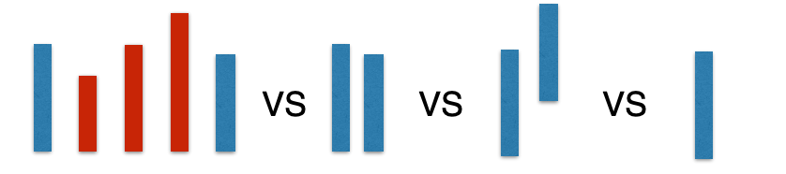
Other factors impacting accuracy
Alignment
Common scale
Distractors

Slide 72
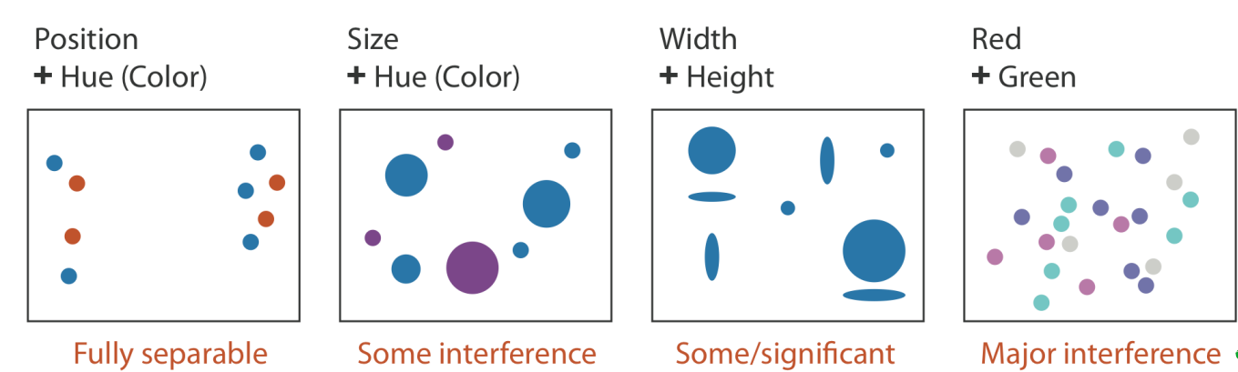
Separability of Attributes
Can we combine multiple visual variables?

Slide 73
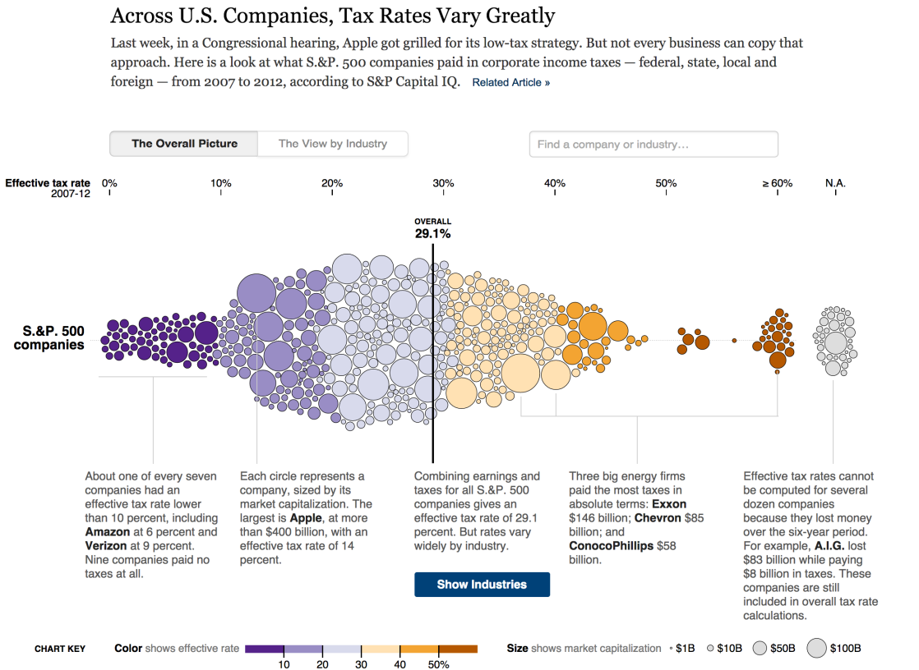
Deconstruct this

Slide 74
What visual variables are used?
Mark – circle
Size of bubble is ‘market capitalization’
Color is tax rate- binned
Position in x is tax rate
Annotations for storytelling

